Slide 1
Climate Projections for [insert your city or region]
INSERT A PHOTO OR A PICTURE OF YOUR CITY OR REGION HERE
[YOUR NAME]
[Your Organization or Institution]
Notes:
This sample template was designed by Katharine Hayhoe, Texas Tech University. katharine.hayhoe@ttu.edu

Slide 2
INTRODUCTION
PART ONE

Slide 3
Our society is built on the assumption of a stable climate
Notes:
The weather goes up and down from day to day and year to year – sometimes it is hot, other times it is cool. Sometimes it is dry, other times it is wet. But overall, we count on the fact that over climate timescales of 20-30 years or more, climate is stable. This USED to be a reasonable assumption, but it is not any longer. Figure by K. Hayhoe

Slide 4
What happens if climate isn’t stable any more?
Notes:
Today, climate is changing. We still have hot and cool months, wet and dry years: but over climate timescales of 20-30 years or more, climate is changing.

Slide 5
THE PURPOSE OF THIS WORK IS:
To produce climate information and projections
that can be used to assess the impacts of climate variability and change
on human and natural systems
at spatial and/or temporal scales that are relevant to impacts in our region and/or city

Slide 6
THE PURPOSE OF THIS WORK IS:
To produce climate information and projections
that can be used to assess the impacts of climate variability and change
on human and natural systems
at spatial and/or temporal scales that are relevant to impacts in our region and/or city

Slide 7
THE PURPOSE OF THIS WORK IS:
To produce climate information and projections
that can be used to assess the impacts of climate variability and change
on human and natural systems
at spatial and/or temporal scales that are relevant to impacts in our region and/or city

Slide 8
THE PURPOSE OF THIS WORK IS:
To produce climate information and projections
that can be used to assess the impacts of climate variability and change
on human and natural systems
at spatial and/or temporal scales that are relevant to impacts in our region and/or city

Slide 9
DATA AND METHODS
PART TWO

Slide 10
Projections for [insert name of city or region]
These projections :
Are based on a subset of 6 of the latest generation of global climate model simulations (CMIP5) that are able to accurately reproduce the Indian Monsoon
Use the higher (RCP 8.5) and lower (RCP 4.5) future scenarios
Have been downscaled to the [insert name of city] weather station as well as to a 30 arc second grid
[insert list of indicators that you will show them]

Slide 11
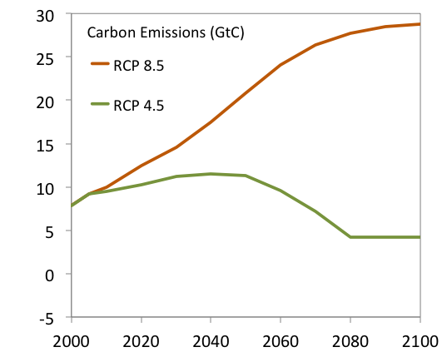
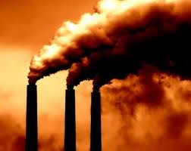
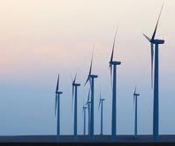
Two future scenarios: higher and lower
Notes:
AOGCMs evaluated in 20+ peer-reviewed journal articles* on ability to simulate key variables relevant to climate that include:
Albedo
Cloud Radiative Forcing
N/S Hemisphere SLP
(Ant-)Arctic surface T & SLP
Antarctic Circumpolar Current
Central US temperature
Indian Summer Monsoon
Indian Ocean Dipole
Teleconnection patterns (ENSO, AO, PDO, PNA, NAO, AMO)

Slide 12
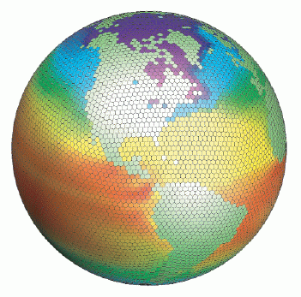
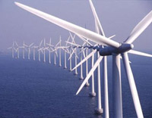
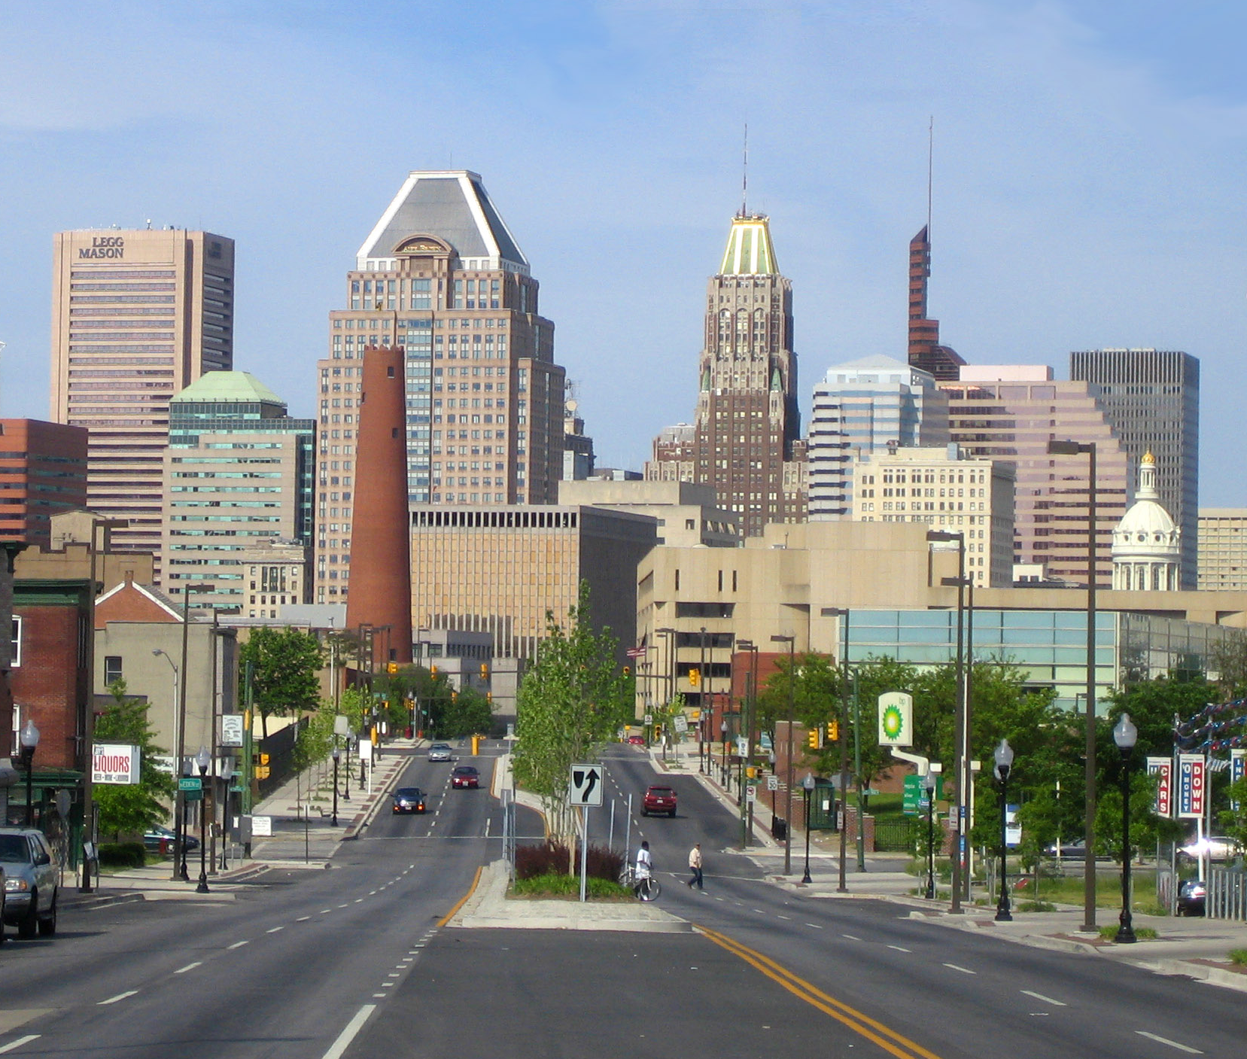
Downscaling from global models to the city level

Slide 13
TEMPERATURE PROJECTIONS
PART THREE

Slide 14
Insert a map, a bar chart, or a time series here

Slide 15
Insert a map, a bar chart, or a time series here

Slide 16
Insert a map, a bar chart, or a time series here

Slide 17
Insert a map, a bar chart, or a time series here

Slide 18
What do we expect … for temperature?
Observed and future changes are consistent with larger-scale trends observed across the India and the world.
On average, summer days and nights will be warmer and high temperature extremes more frequent.
Past mid-century, there are increasingly greater changes under a higher vs. a lower scenario
Notes:
Darker font is used for more robust conclusions. Lighter font for more tentative conclusions.

Slide 19
PRECIPITATION PROJECTIONS
PART FOUR

Slide 20
Insert a map, a bar chart, or a time series here

Slide 21
Insert a map, a bar chart, or a time series here

Slide 22
Insert a map, a bar chart, or a time series here

Slide 23
Insert a map, a bar chart, or a time series here

Slide 24
What do we expect … for precipitation?
Observed and future changes are consistent with larger-scale trends observed across India and the world.
Average precipitation won’t change much, but rainfall will become more variable, increasing risk of both wet and dry extremes
In contrast to temperature, there are no significant differences between scenarios for precipitation in this region

Slide 25
CONCLUSIONS
PART FIVE

Slide 26
CONCLUSIONS
Insert conclusions here

Slide 27
Next Steps
Build our resilience to the risks
we know already exist
Increase resilience to the risks
we know are getting stronger and/or more frequent
Incorporate quantitative climate projections into preparing for risks
we know will intensify under greater change

Slide 28
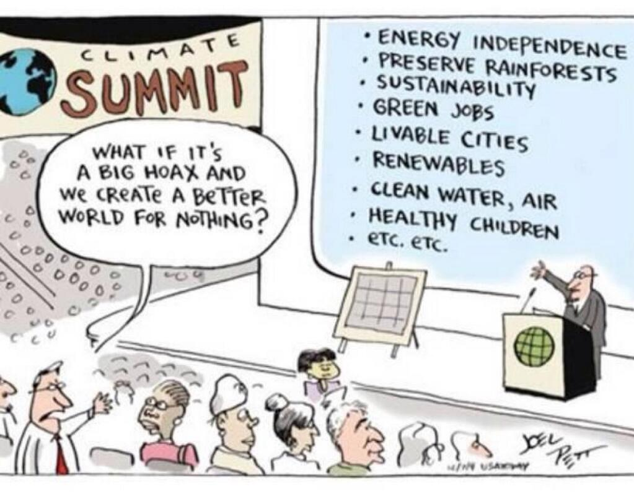

Slide 29
THANK YOU!

