Slide 1
Global Station-based Downscaling with STAR for Future OCDS
Produced by:
North Carolina Institute for Climate Studies
In Collaboration with 14th Weather Squadron
NCICS POC: Carl Schreck; carl_schreck@ncsu.edu
14 WS POC: Jason Patla; jason.patla.2@us.af.mil

Slide 2
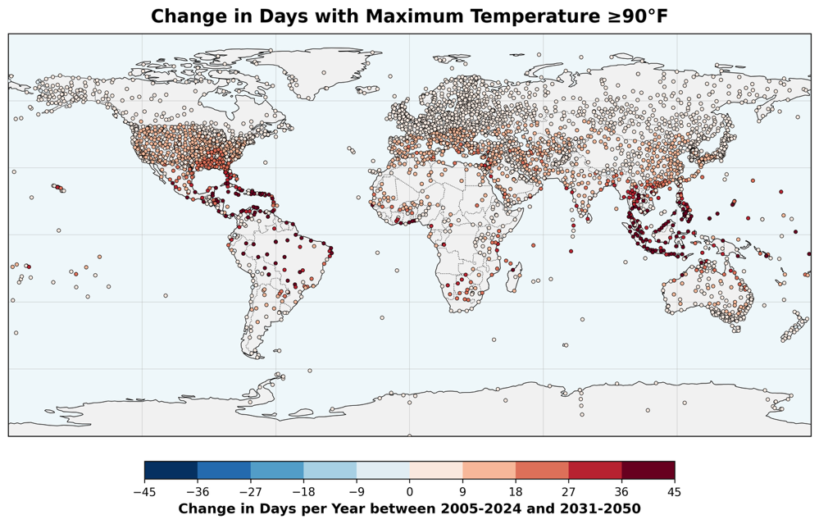
Future Operational Climate Data Summaries (FOCDS)
FOCDS uses 14WS OCDS data to bias-correct CMIP6 projections for variables critical to military operations.
Downscaling with the Seasonal Trends and Analysis of Residuals (STAR) from Texas Tech
Trained on authoritative 14WS OCDS data from ~3k stations—mostly airfields and helopads—around the world with sufficient data for 1990–2024
Daily projections for 2025–2100 for SSP2-4.5, SSP3-7.0, SSP5-8.5
In a split-sample validation, STAR was significantly better than raw interpolated CMIP6 projections.
Max/Min Temperature | Max/Mean Density Altitude (DA)
Dew point | Heat Index (HI)
Wet Bulb Globe Temperature (WBGT) | Fighter Index of Thermal Stress (FITS)
Sea-level Pressure

Slide 3
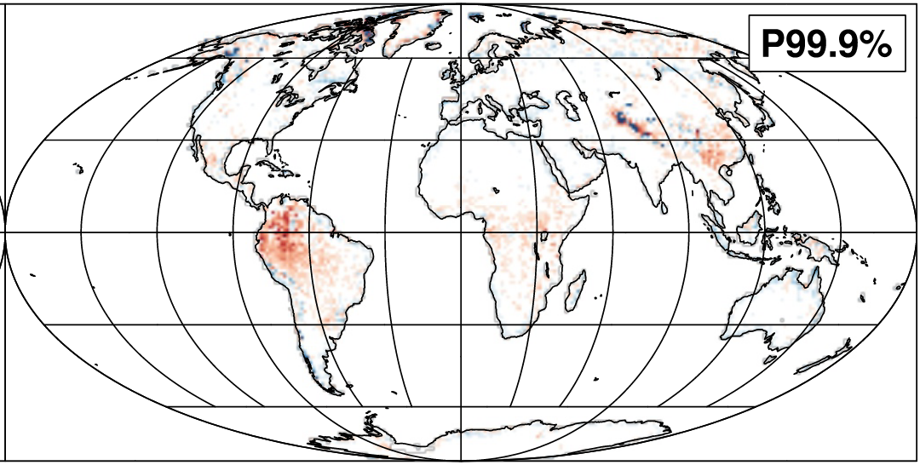
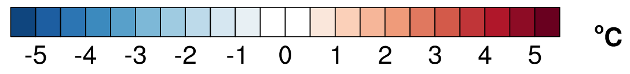
Original STAR Validation Hayhoe et al. (2024)
Maximum Temperature
Hayhoe et al. (2024) validated their algorithm using a “perfect model” method.
Code was converted from matlab to python for cloud scalability.
This is the first application:
Global data
In situ data
Variables beyond temperature and precipitation

Slide 4
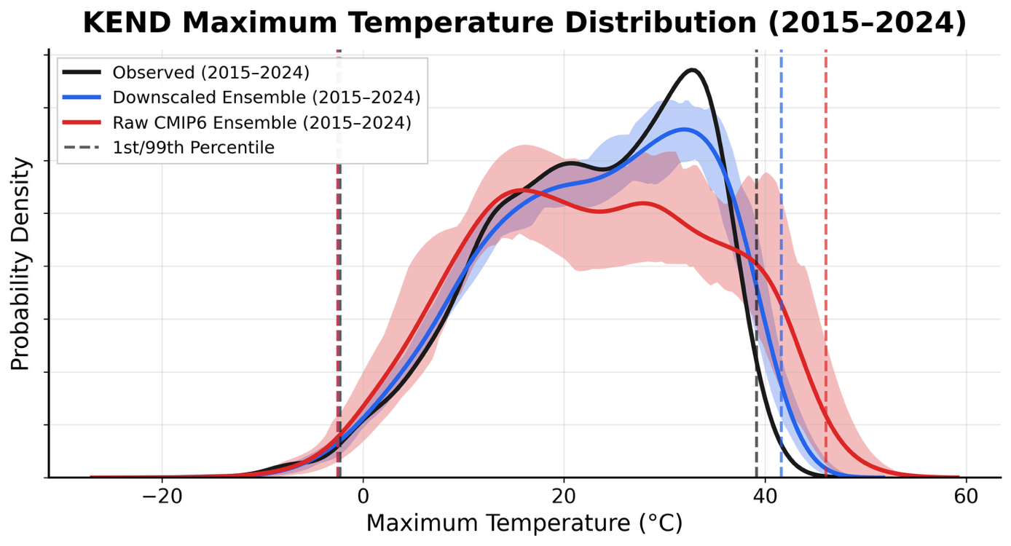
Station-based Split Sample Validation
Observed station data from 14WS OCDS
Training STAR with historical CMIP6 for 1990–2014
Validating with CMIP6 SSP2-4.5 for 2015–2024
Vance Air Force Base, Oklahoma

Slide 5
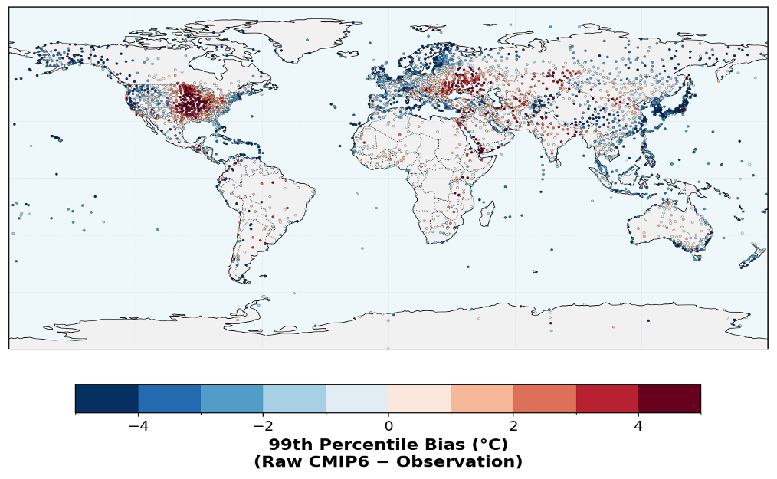
Raw Interpolated CMIP6 Ensemble Mean Bias
Eastern U.S. and Eastern Europe are too warm.
Western Europe, coastal regions, and islands are too cool.

Slide 6
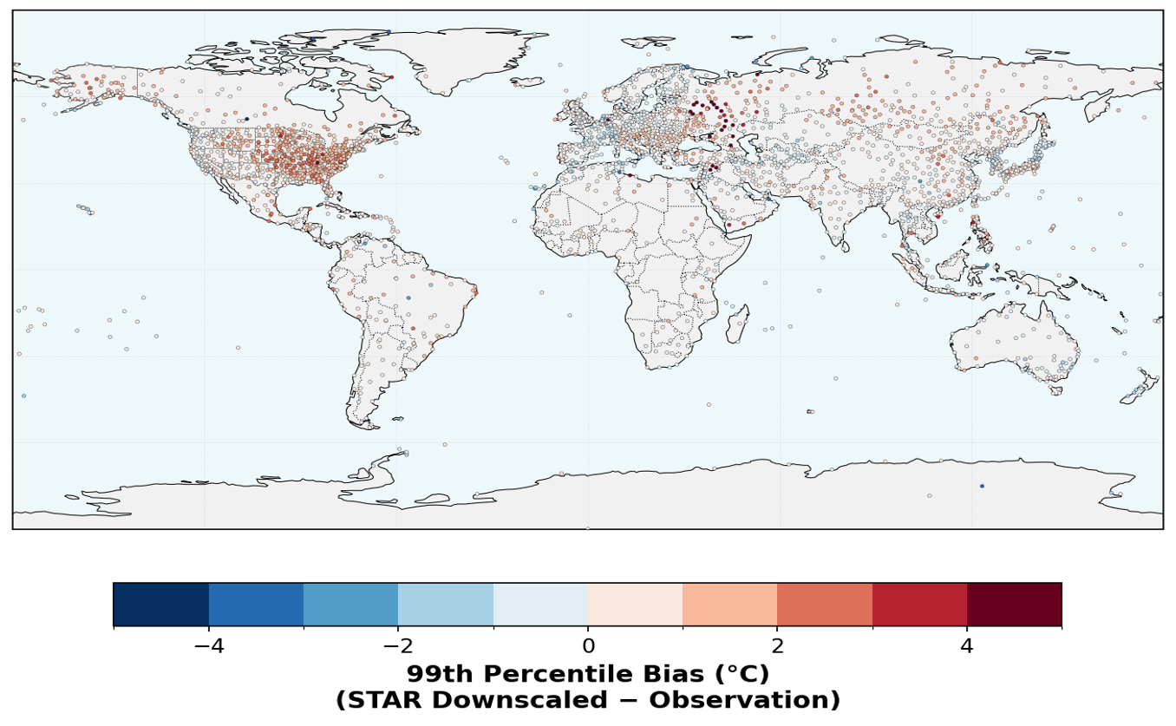
STAR Downscaled CMIP6 Ensemble Mean Bias
STAR reduces the biases by >50%.

Slide 7
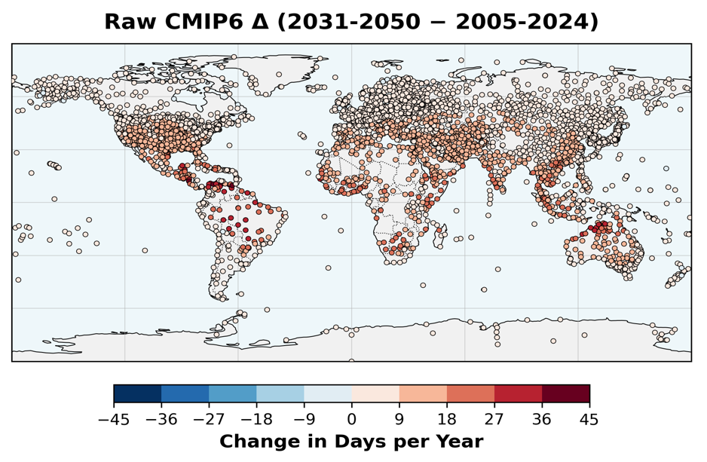
Days > 90°F
Raw CMIP6 projects an increase of up to 20 days per year.

Slide 8
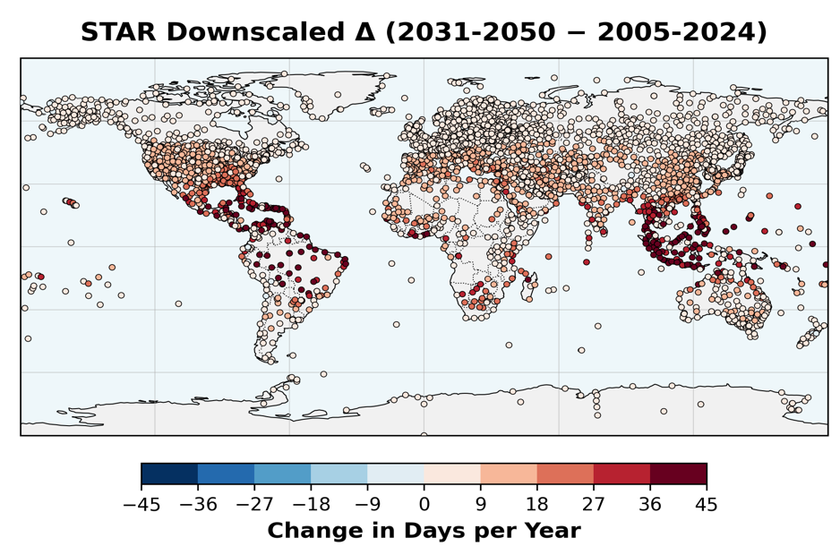
Days > 90°F
Raw CMIP6 projects an increase of up to 20 days per year.
STAR shows an increase almost twice as large, particularly in the tropics.

Slide 9
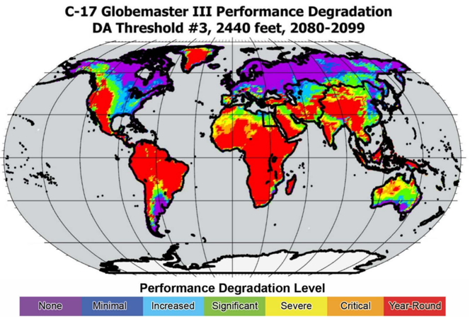
Background: Density Altitude
Density Altitude (DA) combines temperature, pressure, and humidity.
Higher DA means decreased aircraft performance (lift/thrust), which increases runway requirements.
Operators reduce maximum takeoff weight (MTOW) to compensate: less payload or fuel.
The example on the right shows projected degradation for C-17 from a recent study.
Benton, K. M., and T. F. Leslie, 2023: Barriers to Force Projection: Climate Change and Aerial Forward Operability. Air & Space Operations Review, 2, 4–19.

Slide 10
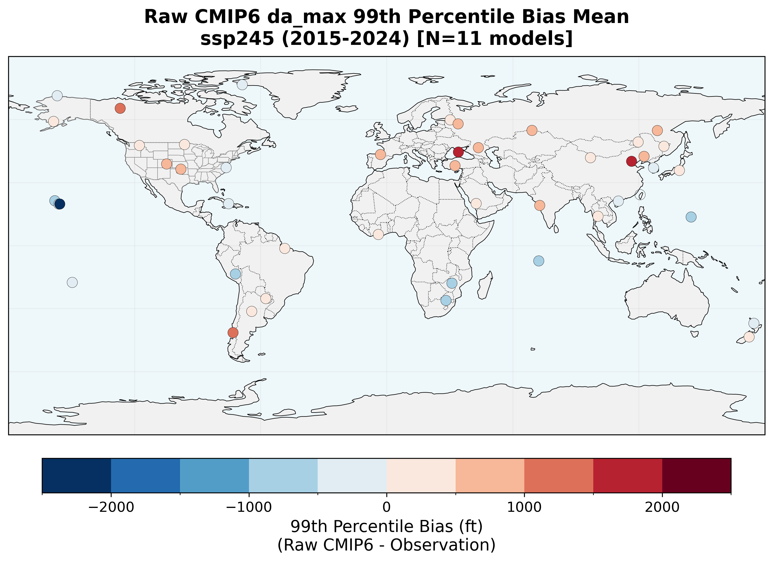

Density Altitude 99th Percentile Bias
STAR reduces the mean absolute error by >80%.
Representative sample of ~40 stations used for testing

Slide 11
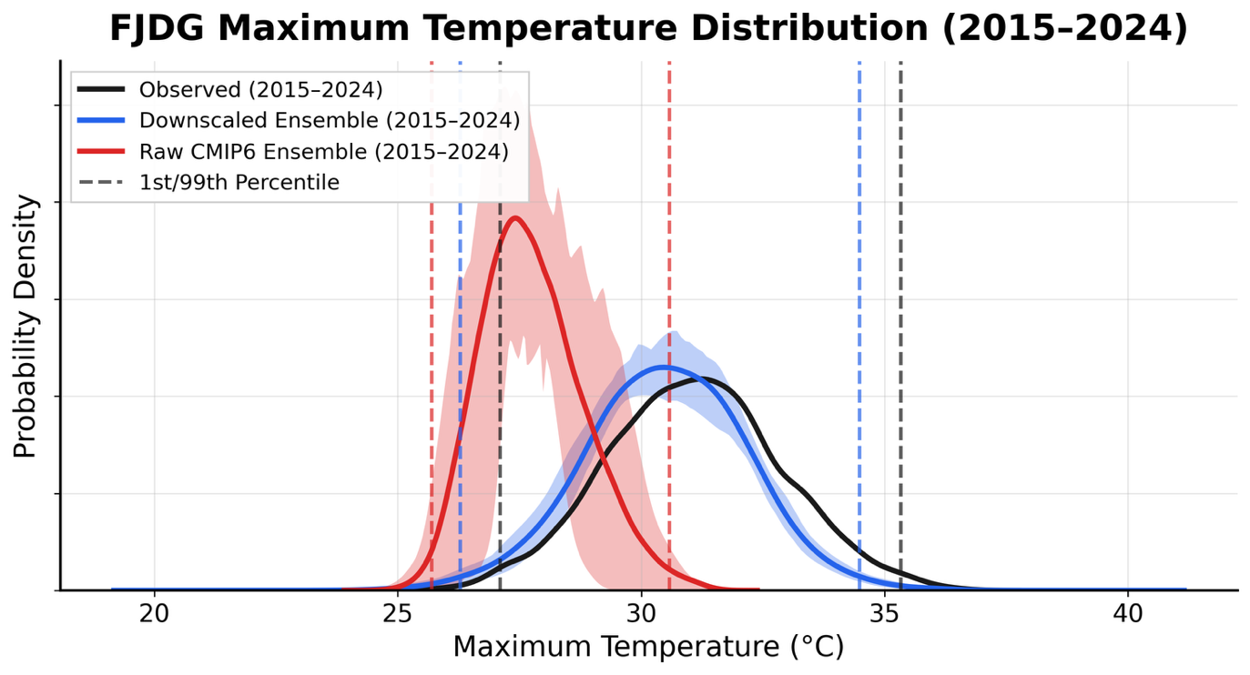
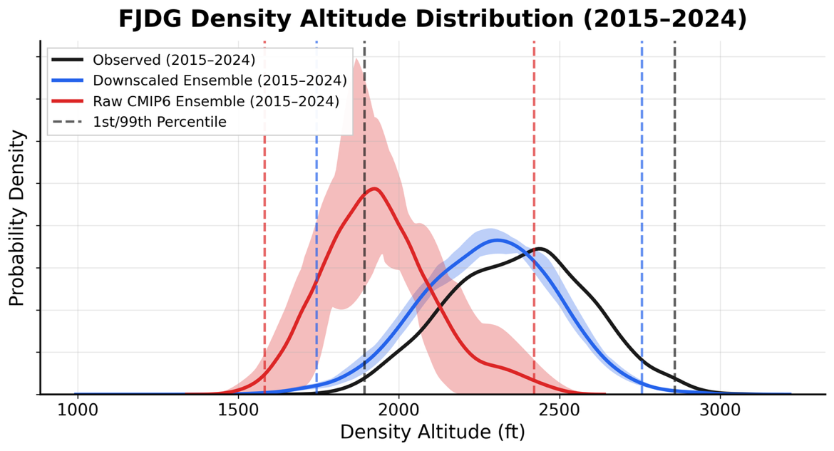
Diego Garcia, Indian Ocean
Small atoll in central Indian Ocean
Temperatures are much too low in raw CMIP6 models—probably doesn’t have the island.
Density Altitude has similar issues.
STAR fixes both!

Slide 12
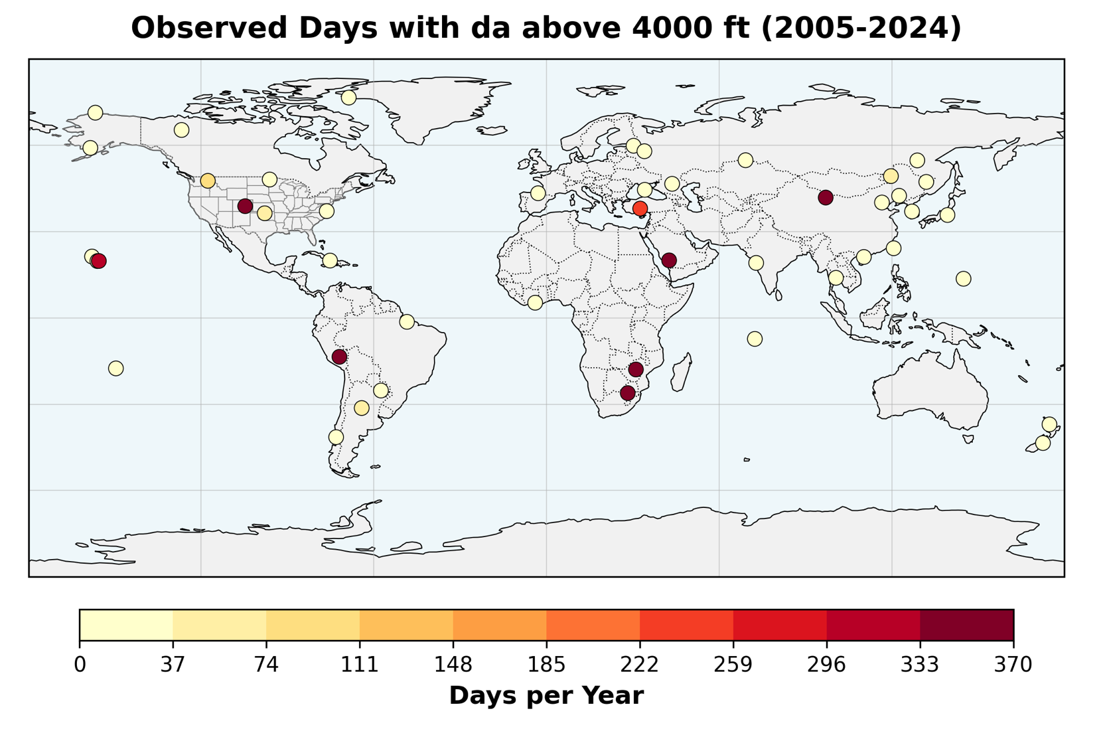
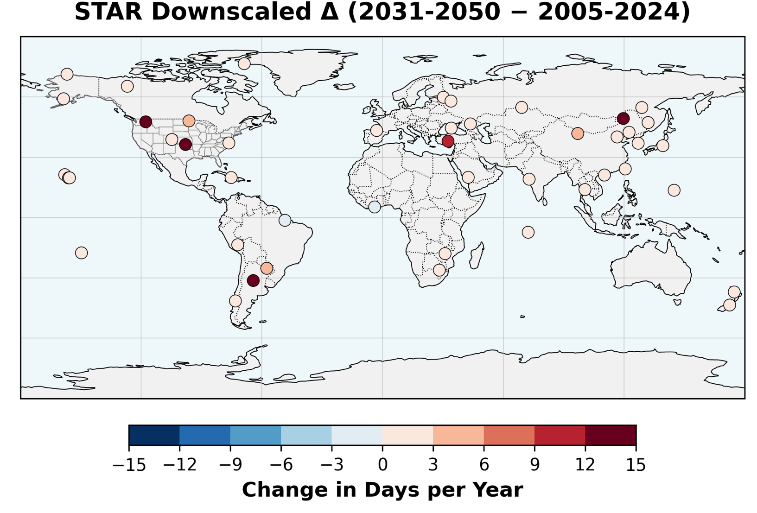
Density Altitude >4000 ft
Higher elevations or low-latitudes may already exceed 4000 ft every day.
STAR for SSP2-4.5 projects increases of ~2 weeks per year for several stations.

Slide 13
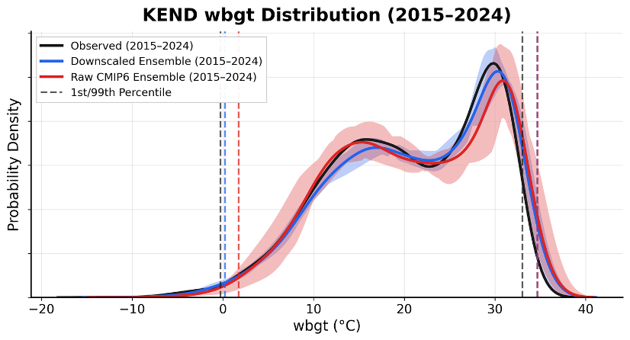
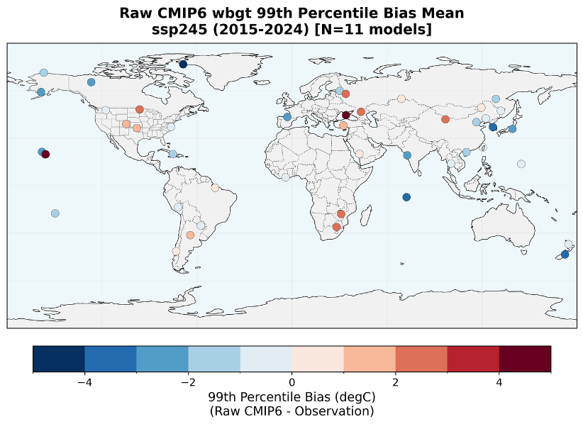
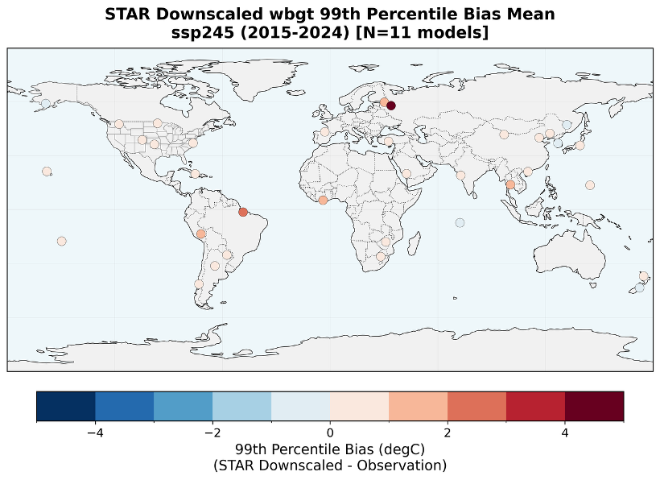
Wet Bulb Globe Temperature (WBGT)
STAR reduces the biases for the 99th percentile WBGT at most stations.

Slide 14
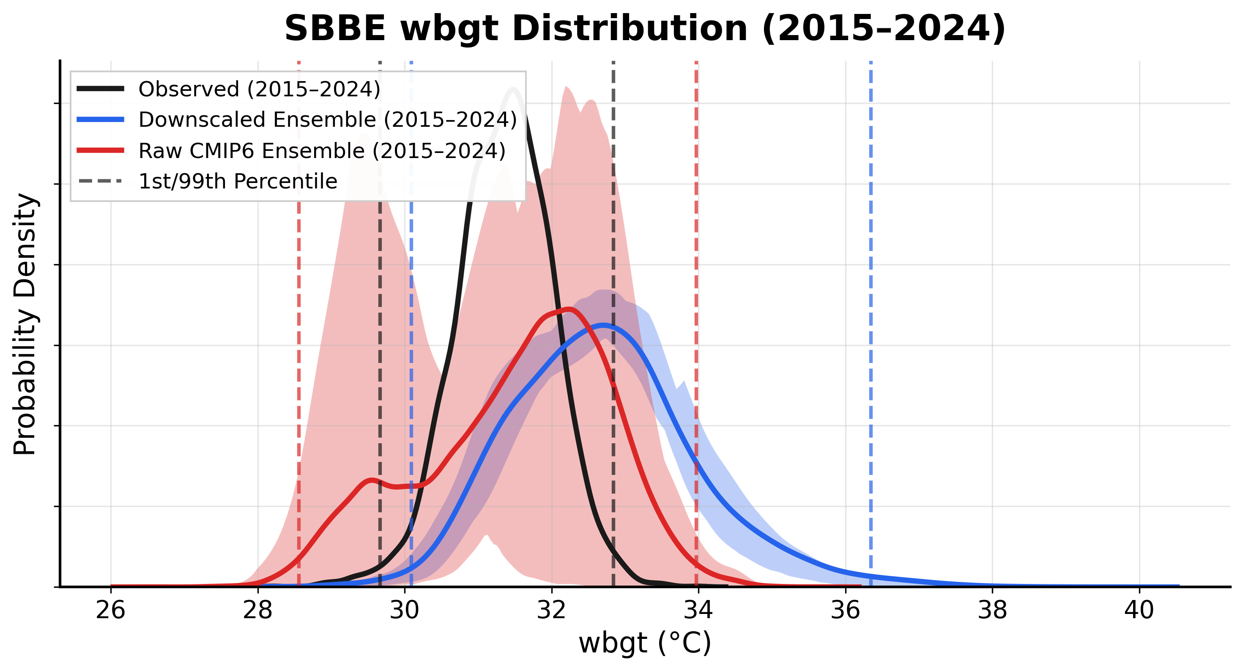
Wet Bulb Globe Temperature (WBGT)
…but it cannot replicate the distribution at Belém Brazil (SBBE). This is one of the only failures we’ve found in the STAR projections.

Slide 15

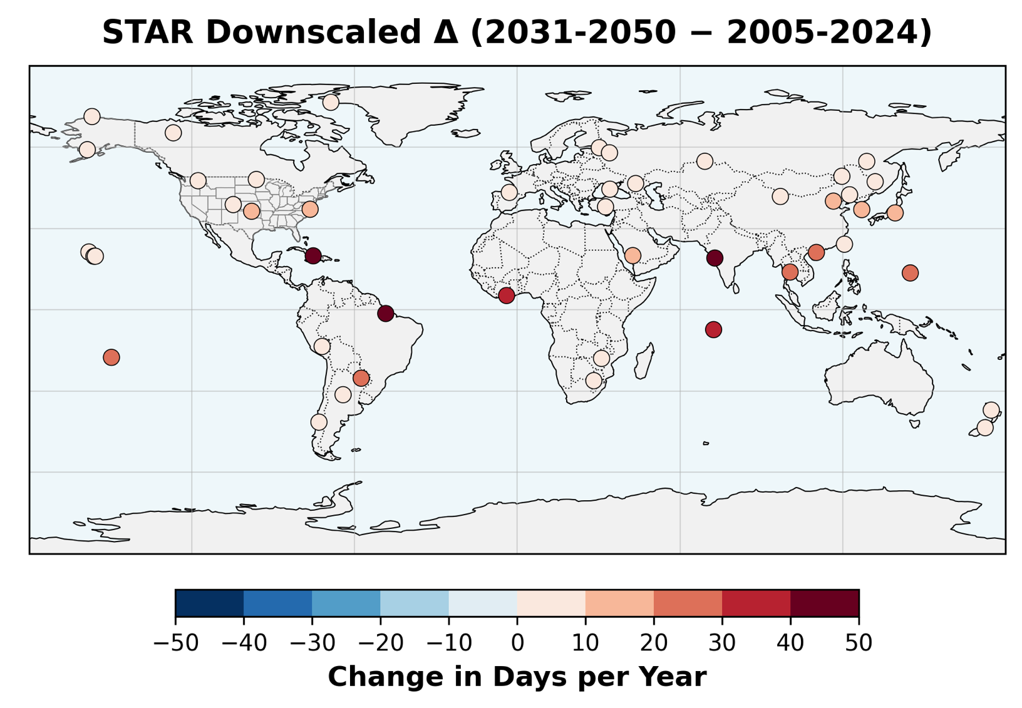
Black Flag: WBGT >90°F
Mostly occurs over tropical coastal regions in the present climate.
STAR for SSP2-4.5 projects >20 additional days at tropical locations.
Eastern U.S. and northeastern Asia would see 10–20 additional days.

Slide 16
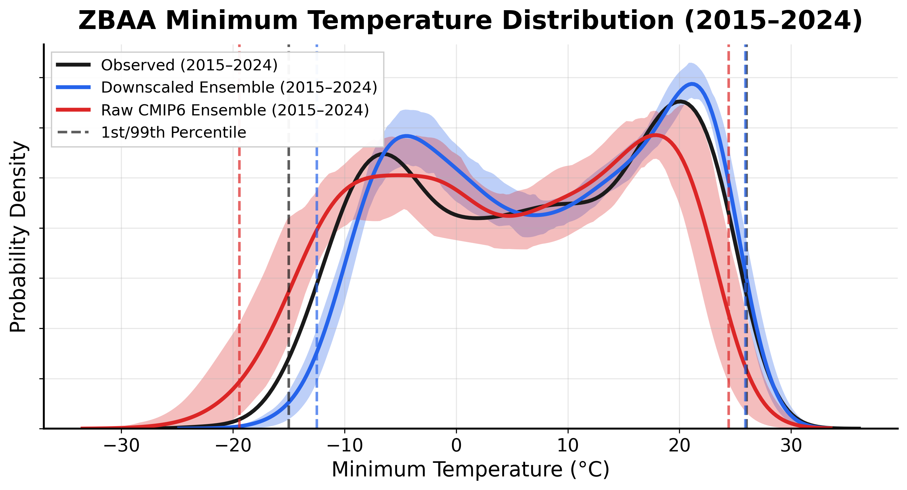
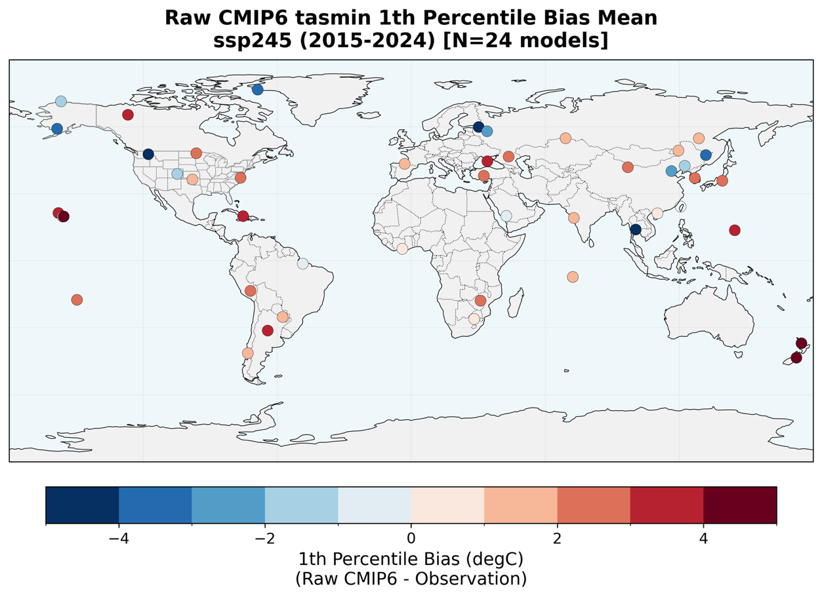

Minimum Temperature
STAR has a warm bias for the coldest minimums at Beijing (ZBAA), but it’s still closer than the raw CMIP6 models.

Slide 17
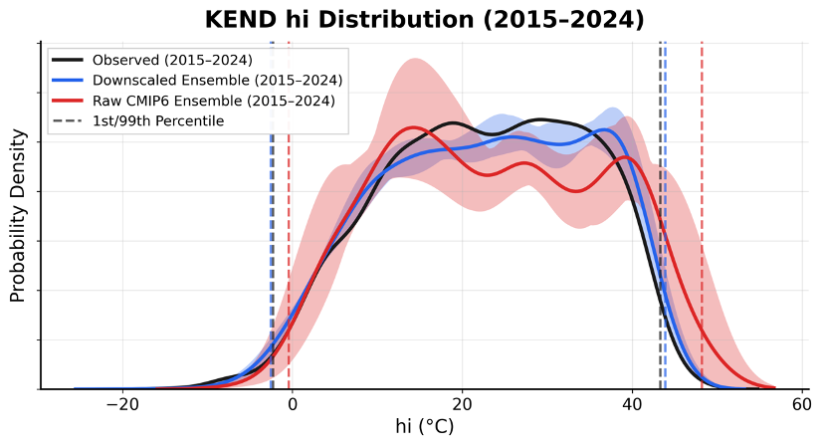
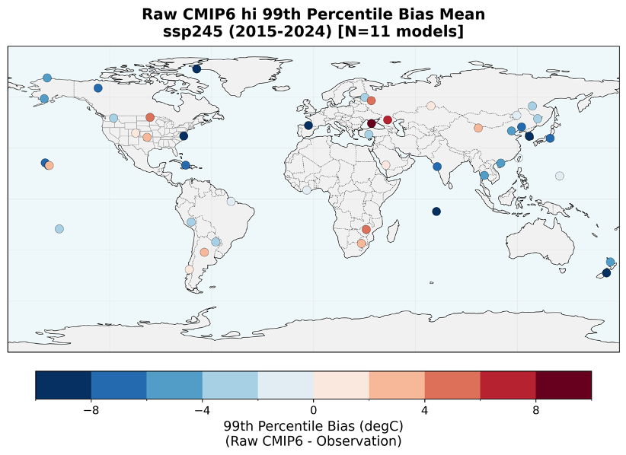

Heat Index
STAR reduces the biases for Heat Index at most stations, including KEND.

Slide 18
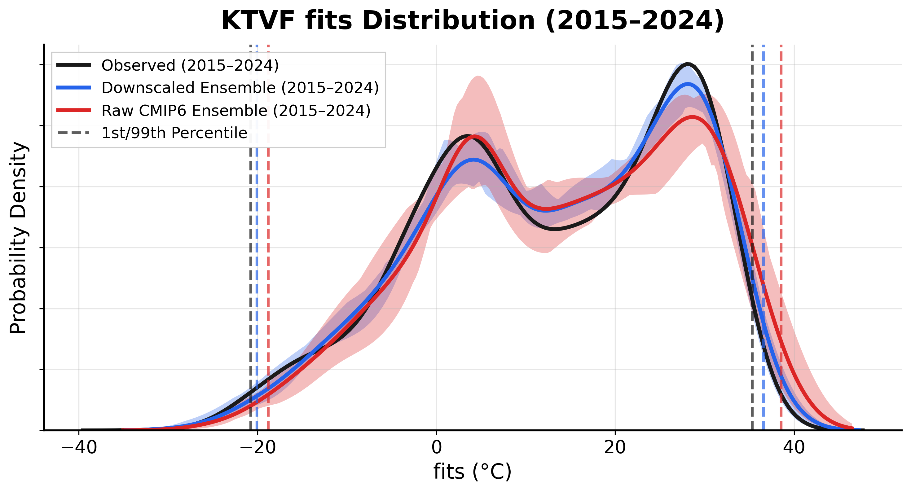


Fighter Index of Thermal Stress (FITS)
Biases are generally smaller for FITS than other temperature-based variables, but STAR still makes improvements.

Slide 19
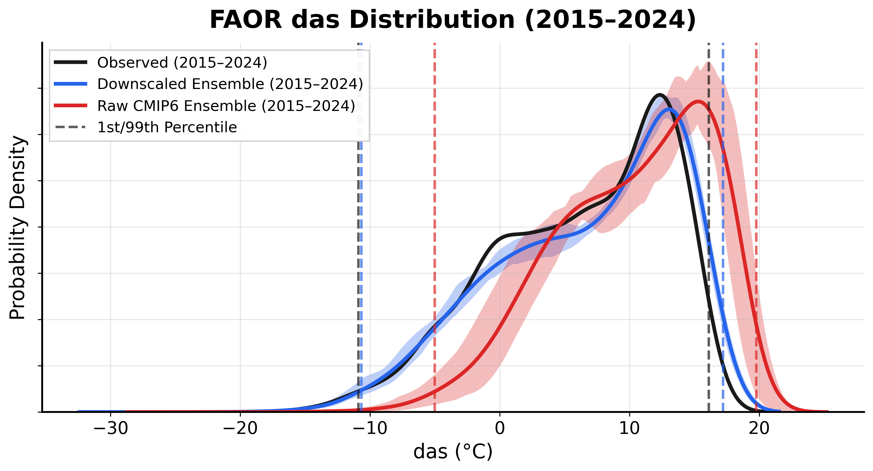
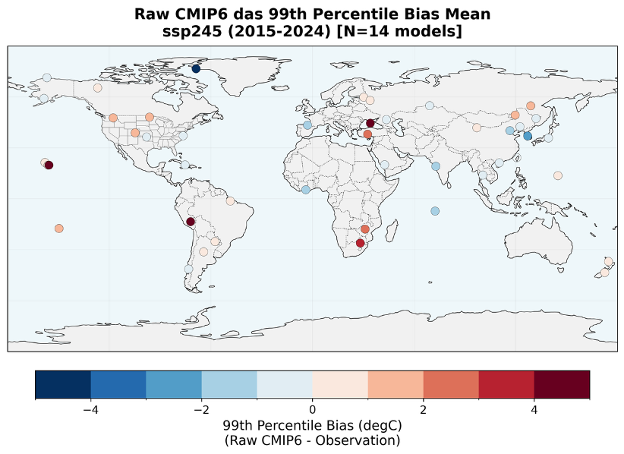

Dewpoint
Models are too moist at Johannesburg (FAOR), and STAR reduces the bias.

Slide 20
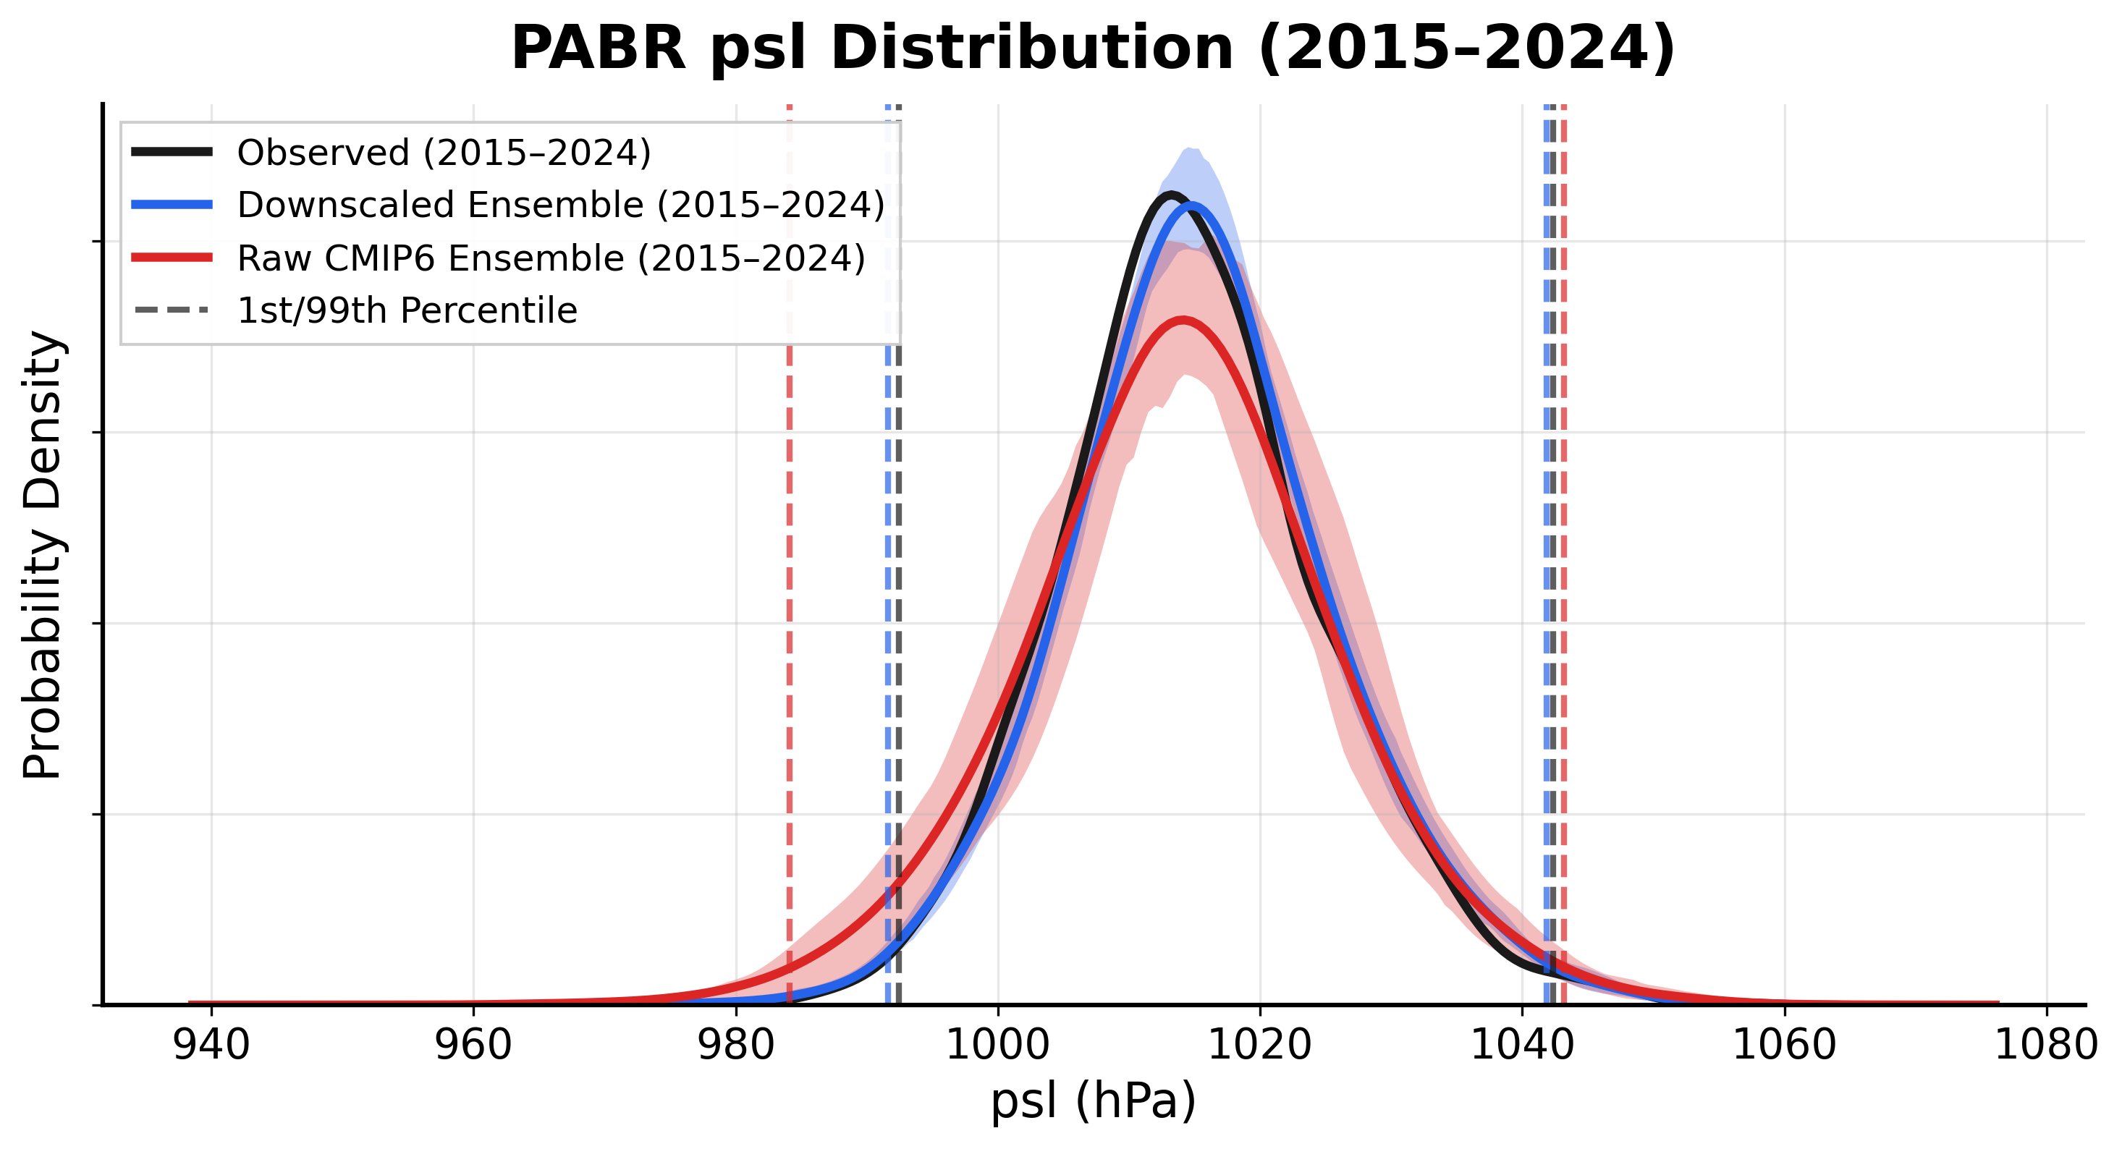
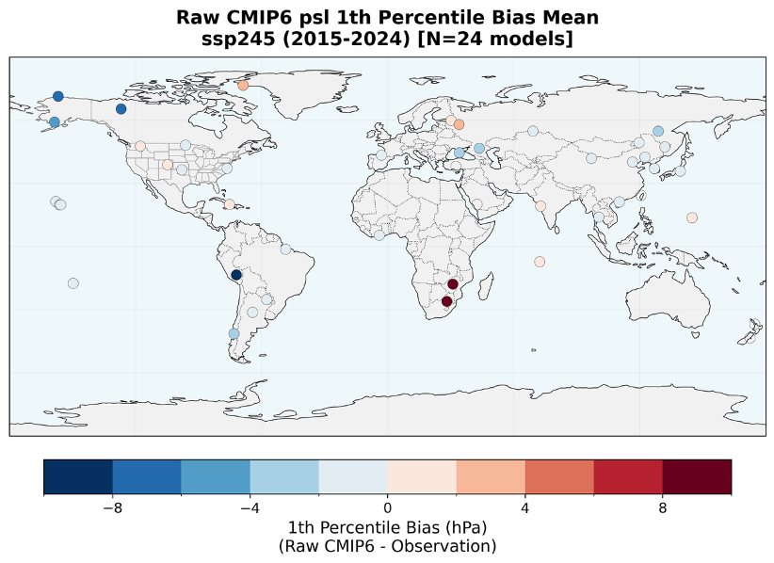

Sea-level Pressure
STAR corrects a bias for lowest pressures at Barrow (PABR).

Slide 21
Future Operational Climate Data Summaries (FOCDS)
FOCDS uses 14WS OCDS data to bias-correct CMIP6 projections for variables critical to military operations.
Downscaling with the Seasonal Trends and Analysis of Residuals (STAR) from Texas Tech
Trained on authoritative 14WS OCDS data from ~3k stations—mostly airfields and helopads—around the world with sufficient data for 1990–2024
Daily projections for 2025–2100 for SSP2-4.5, SSP3-7.0, SSP5-8.5
In a split-sample validation, STAR was significantly better than raw interpolated CMIP6 projections.
Max/Min Temperature | Max/Mean Density Altitude (DA)
Dew point | Heat Index (HI)
Wet Bulb Globe Temperature (WBGT) | Fighter Index of Thermal Stress (FITS)
Sea-level Pressure

