Slide 1
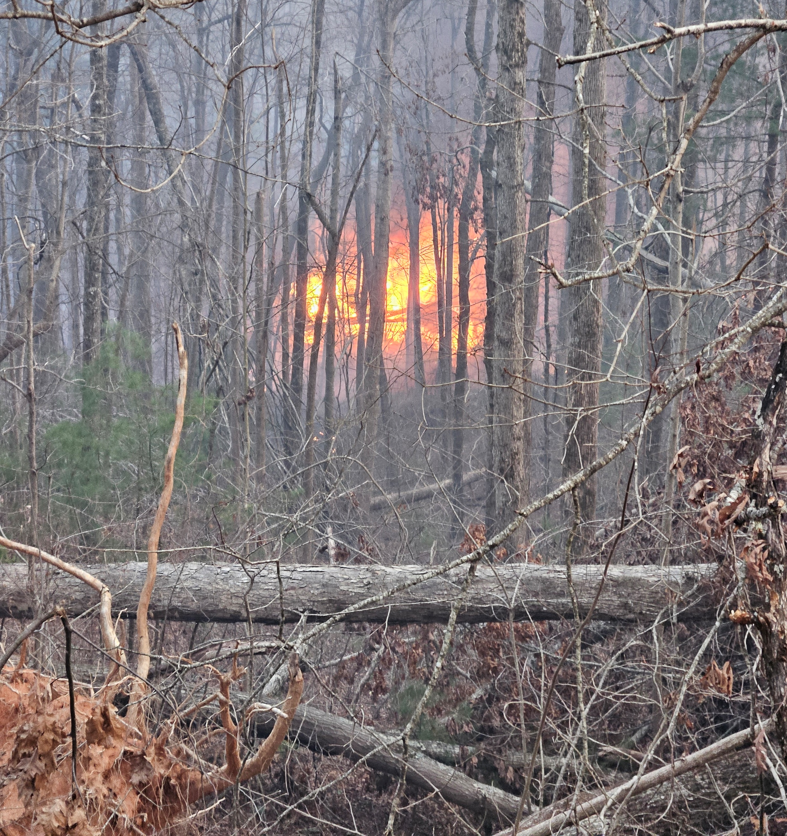
Black Cove Complex Lessons Learned
Michael Good
NC Forest Service
Incident Commander

Slide 2
Structure Impact

Slide 3
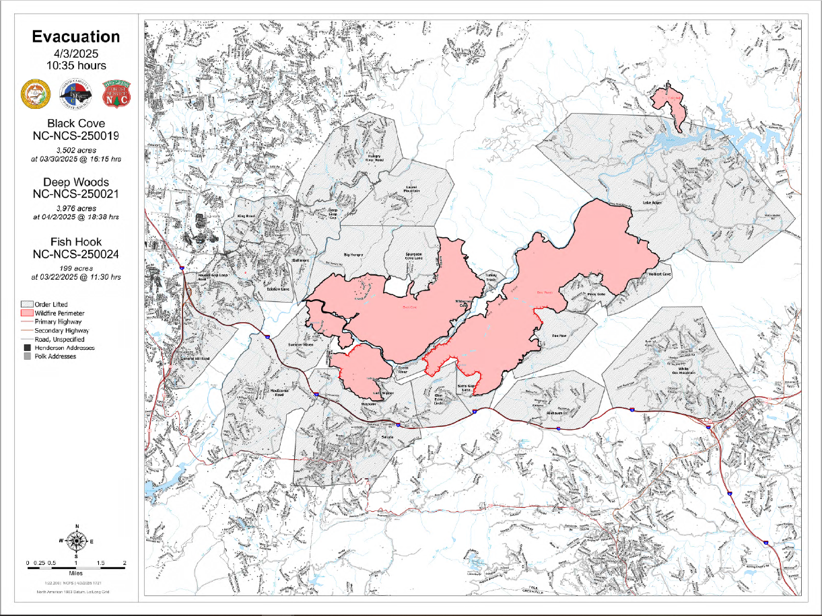
Evacuation Zones

Slide 4
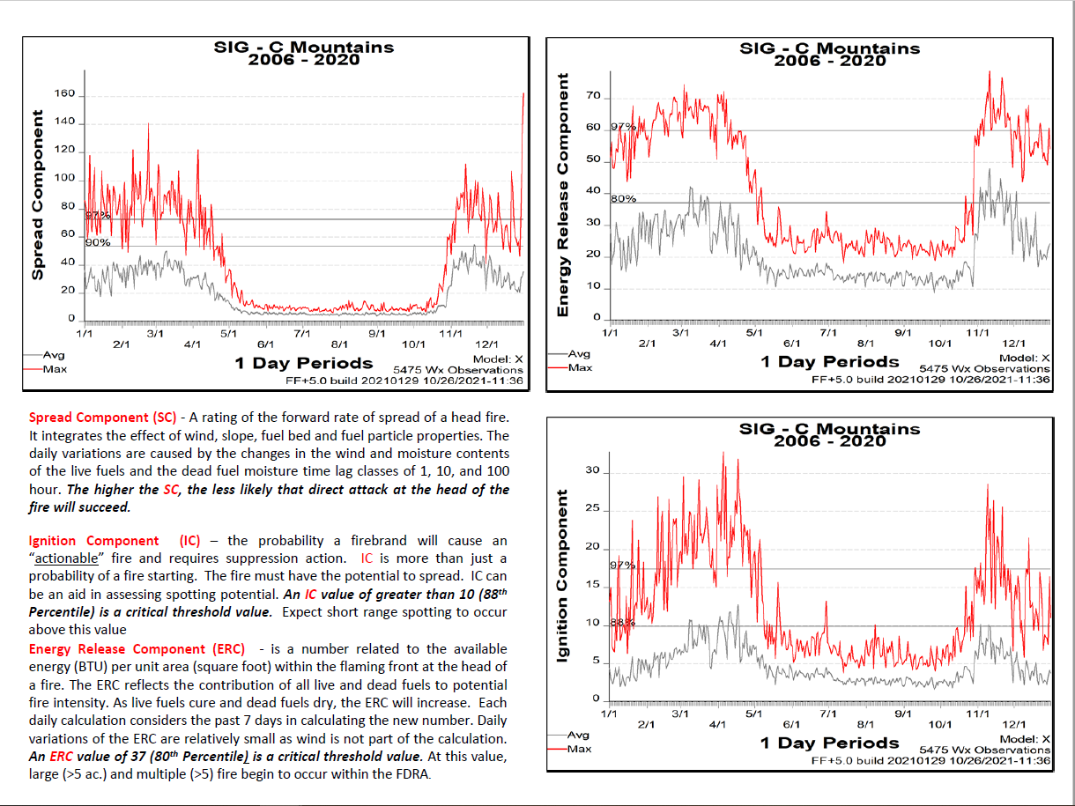
Fire Danger

Slide 5
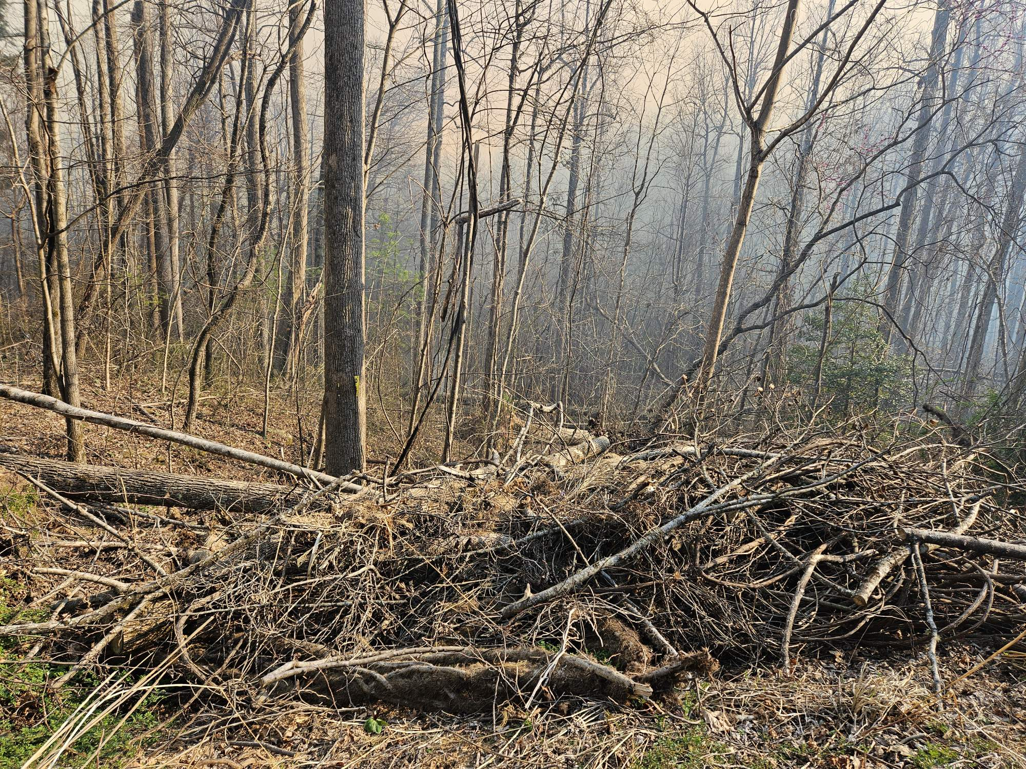
Helene Damage

Slide 6
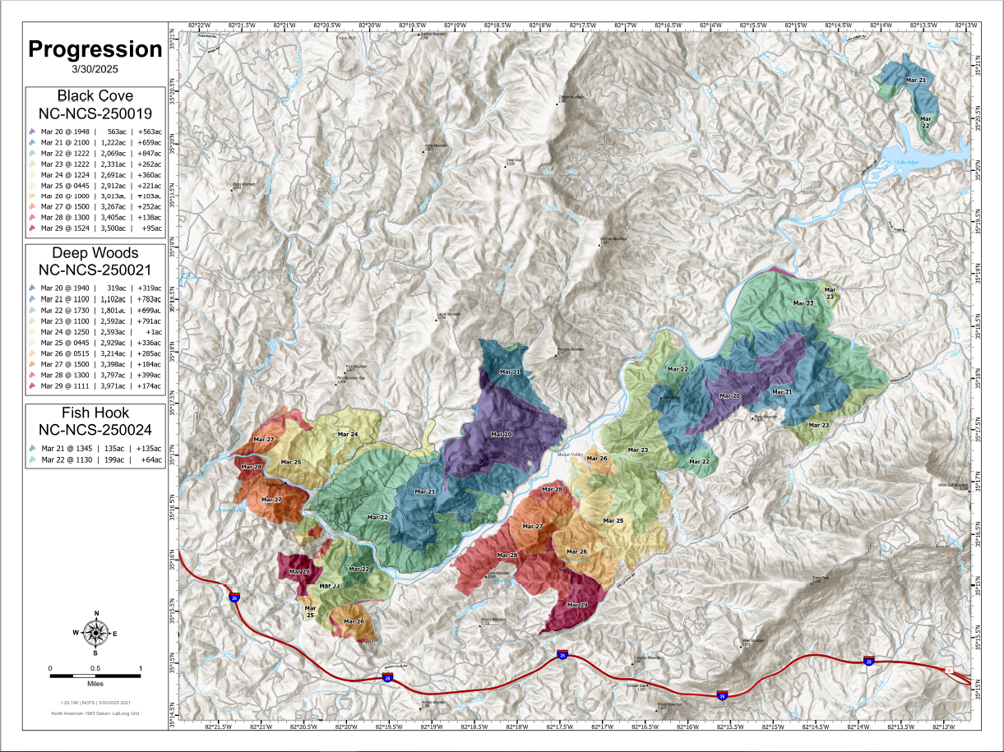
Fire Progression

Slide 7
Take Home Points
Early connection with local State, County and structure resources
Early coordination about evacuation and road closures
Recognition of fire danger – specifically Helene damage impacts
Requesting and assigning adequate resources

