Slide 1
Hazard Mitigation Steve McGugan Assistant Director – HM State Hazard Mitigation Officer (SHMO)

Slide 2
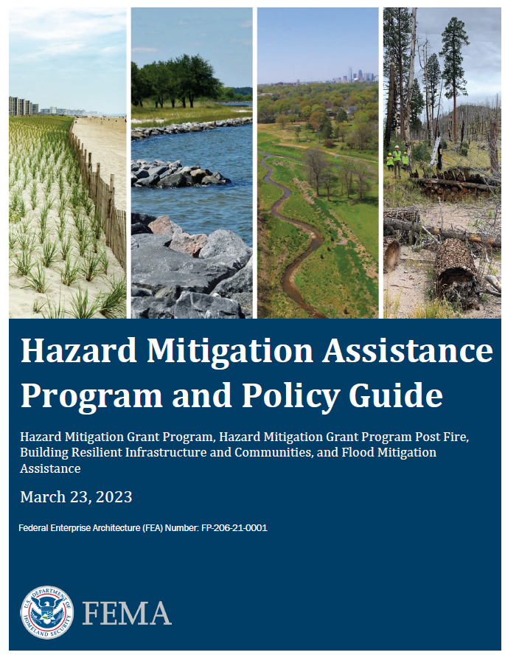
What is the Hazard Mitigation Grant Program (HMGP)?
HMGP is 1 of 4 Hazard Mitigation Assistance (HMA) grants provided by FEMA, focused at providing post-disaster assistance while simultaneously reducing risks to individuals and property from future disasters.
HMGP’s focus is ensuring effective Governmental actions incorporate critical mitigation measures to reduce risk during post-disaster reconstruction
Focused at breaking the cycle of damage, reconstruction and repeated damages
Specific Focus Areas:
Community-wide risk reduction projects
Improving resilience of key infrastructure and resource life-lines
Encouraging conservation of the floodplain
Increasing future mitigation planning

Slide 3
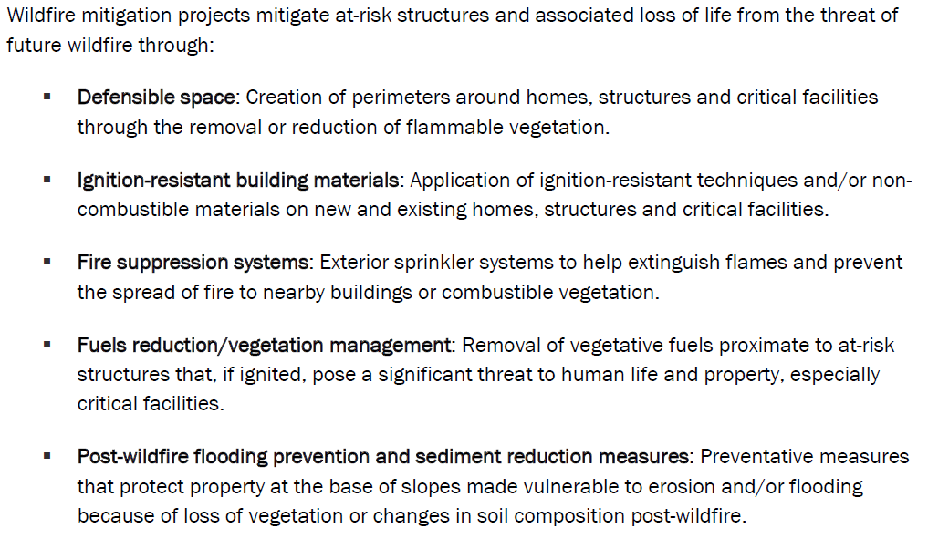
HMGP-Post Fire Project Types

Slide 4
Key Actions to Successful Applications
Must have Wildfire Mitigation Actions in your Regional Hazard Mitigation Plans
Assistance only for clearly defined vulnerable buildings and structures.
Eligible wildfire mitigation projects must clearly demonstrate mitigation of the risk from wildfire to residential and non-residential buildings and structures, including public and commercial facilities.
Projects must be in a Wildland Urban Interface, be adjacent to or intermingled with the built environment, and provide protection to life and the built environment from future wildfires.

Slide 5
Other Considerations
Building the History of hazards
Clearly defined Scope of Work
Clearly defined time
Good Cost Estimates
Helping us build the Benefits Cost Ration
Finally: Understanding the time to Build and Approve

