Slide 1
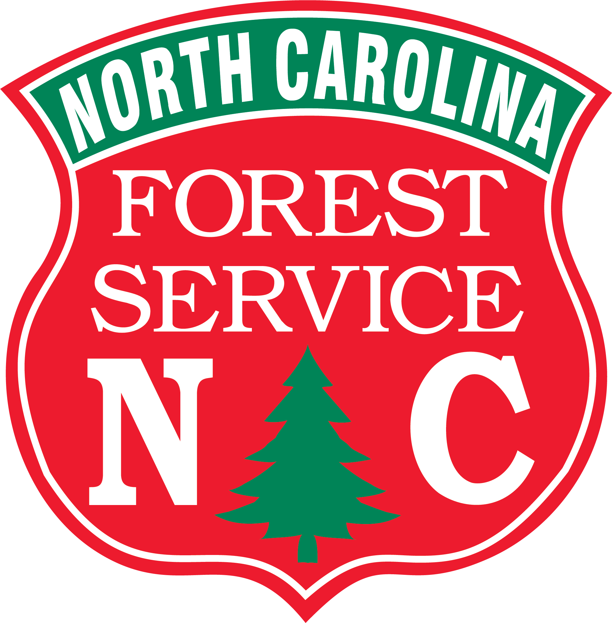
North Carolina Forest Service Prevention & Mitigation Programs
Robbie Perry
Fire Chief, North Carolina Forest Service

Slide 2
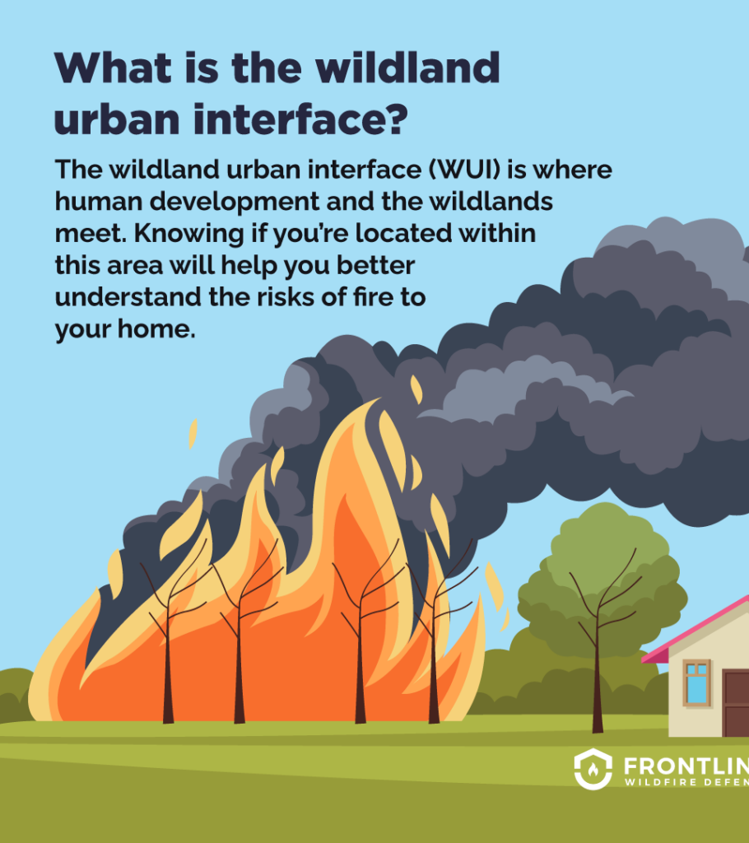
North Carolina and the Wildland Urban Interface (WUI)
North Carolina is #1 in the Nation of area (acres) in the WUI (Wildland Urban Interface), (13,402,007 acres of 33,708,881 acres), 39.8 percent.
North Carolina is #4 in the nation for number of homes in the WUI (2,247,317 homes of 4,327,528 homes), 51.9 percent.
North Carolina is #4 in the nation for the number of people in the WUI (4,835,825 of 9,535,483 people), or 50.7 percent.

Slide 3
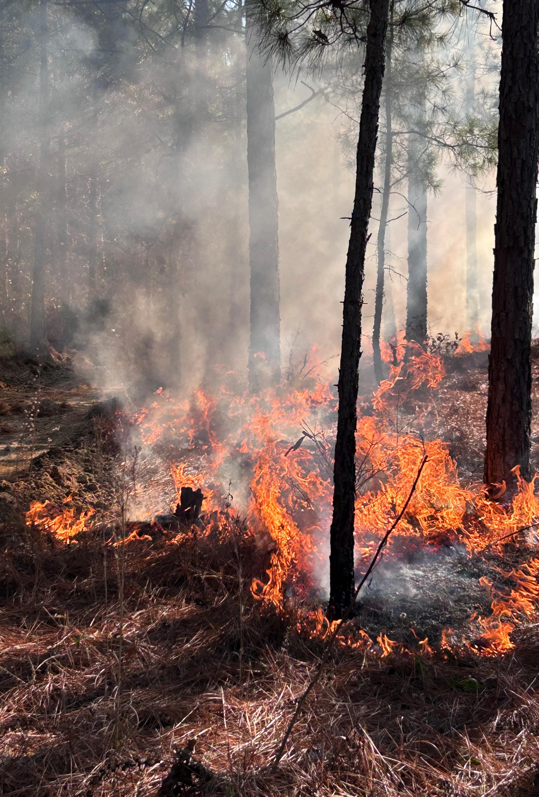
Hazard Reduction Burning
Burning to reduce the hazardous buildup of forest fuels.
Fastest method & most cost-effective way of reducing forest fuels.
In 2024, there were a total of 568 burns reported to NC Forest Service for a total of 69,209 acres burned. (27.6% or 157 burns completed by NCFS)
NC Forest Service can contract with landowners to burn tracts at a rate of $35.00 per acre.

Slide 4
Community Protection Plans (CPP)
Grant program that provides funding to states to prevent wildfires and mitigate fire hazards that threaten communities surrounding national forestland.
Applies to tracts of forestland lying with a 10-mile buffer to any National Forest.
Tracts within the buffer qualify for free hazard reduction burning by NC Forest Service.

Slide 5
Resist Wildfire North Carolina
Homeowner or community-based idea where the residents take the lead in designing a wildfire resistant community
Firewise USA Is a collaborative program that brings homeowners and fire agencies together to provide residents with the tools to mitigate wildfire risk around their homes.
North Carolina Forest Service Fuels Removal Program is free program for homeowners & communities paid for by the North Carolina Community Firewise Mitigation Grant.
Contractors pick up and remove piles from along the roadside.
Piles must be within 5 feet of the roadside and arraigned in piles 4 ft. by 4 ft. by 8 ft.
Minimum of 20 piles but no more than 50 piles to qualify.
Annual application period.

Slide 6
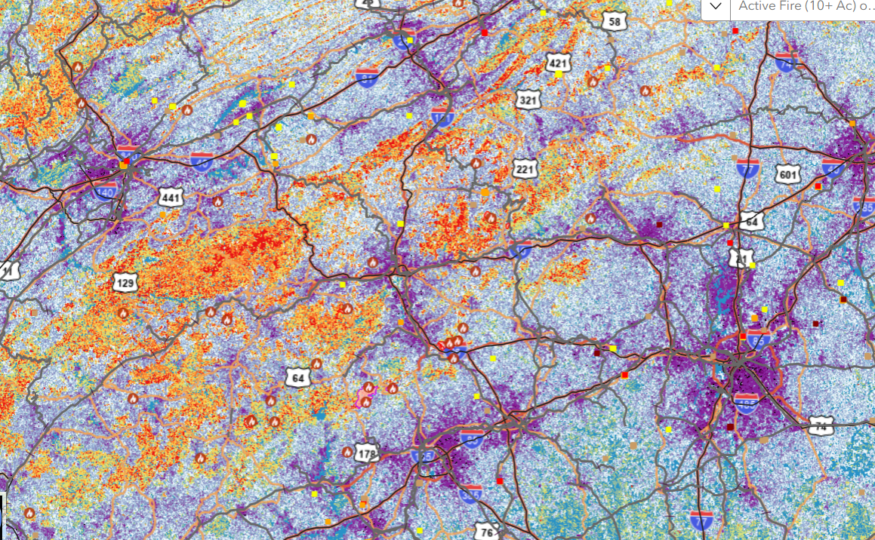
Community Wildfire Protection Plans (CWPP)
Collaborative effort involving local NC Forest Service, fire department, emergency management personnel, and local officials to identify and address wildfire risk in a community.
Development of a written document that identifies high risk areas within a local fire district and potential mitigation projects that may reduce some risk to the urban interface.

Slide 7
Volunteer Fire Assistance Program
Matching funds program of up to $5,000.00 to qualifying fire departments.
Department must serve a population of less than 10,000 people.
Grant funds are to be used to procure wildland fire fighting equipment, PPE, or selected supplies.
Annual application period in the fall of the year.

Slide 8
Mechanical Fuels Removal
Fuel removal with mastication equipment.
Grinding/mulching of forest fuels
Good option for small projects where burning is not an option due to smoke sensitivity.
Four projects completed in 2024 (Surry, Transylvania, Watauga, & Mitchell Counties).
Total acreage: 35.7 acres completed in the 2024 calendar year.

Slide 9
Robbie Perry
Fire Chief, North Carolina Forest Service
1616 Mail Service Center
Raleigh, NC 27699
Robbie.Perry@ncagr.gov

