Slide 1
Potential Operational Delineation (PODs)
USDA Region 8
Notes:
Good Afternoon! Today we are here to talk about Potential Operational Delineations (PODS) so that when we are at the workshops the week of May 19th, we are able to spend the entire day drawing lines and having those cross boundary conversations. Today is the day we want to address what PODS are and answer any questions that may be out there on PODS and the workshops.
Ideally, this training is going to be more conversational. Yes, I have a powerpoint we are going to go thru, but its much more enjoyable for everyone involved if we can have discussion about what is being talked about throughout. So please don’t wait until the end to ask questions if you have them, either raise your hand in teams, or just come off mute and interrupt me. You can also throw any questions in the chat window, and my colleges will see that and cut me off for you.
Before we start, I want to quickly introduce my Enterprise Staff that will be working on the project with me, and then I will have Dave Quisenberry introduce himself, and then I will have Greg Philipp introduce himself and kick us off with a leaders intent for the project.

Slide 2
Overview
Strategic Fire Management
What is a POD?
How do we draw POD lines
Applications
Notes:
This presentation is designed to provide an introduction to PODS (Potential Operational Delineations) and their applications. We begin by defining spatial fire management, define what a POD is and what it is not, and we will discuss what the workshops will look like when we are all in the room, drawing lines. And finally, we discuss applications and how PODS fit into a broader strategic fire planning ecosystem.

Slide 3
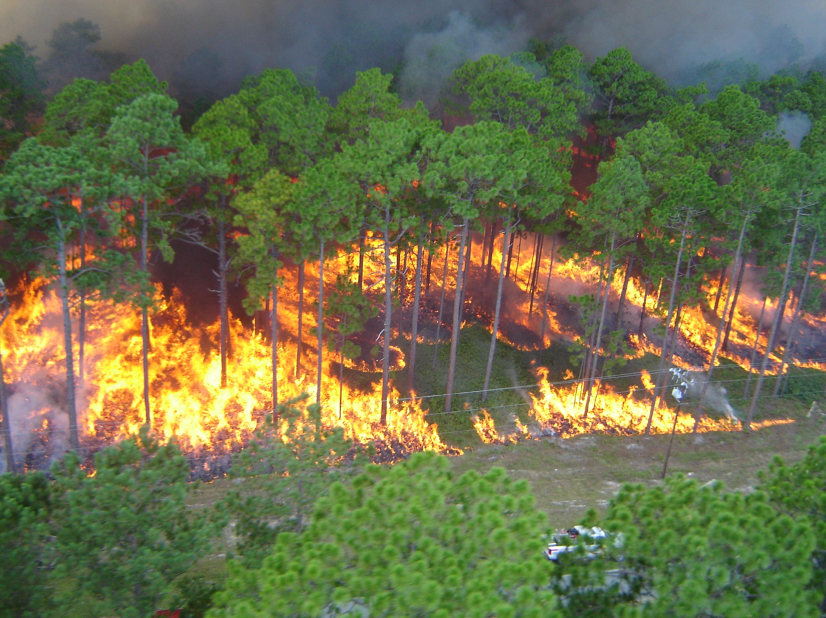
What is Strategic Fire Management?
A process using expert knowledge that is designed to improve fire management outcomes by reducing loss and maximizing benefit as safely and efficiently as possible.
Best ridge vs next ridge
Notes:
What is Strategic Fire Management? In short, it is a process that uses expert knowledge and best available science to improve fire management outcomes by reducing loss and maximizing benefit to a landscape as safely and efficiently as possible.
An even more simplification of that, is the idea of “the best ridge to hold this fire may not necessarily be the next ridge” so best ridge vs next ridge. PODs are a proxy that fits into this concept. By drawing PODS we are promoting cross boundary buy-in to improve fire management tactics that better the landscape and its resources not only during the pre season with fuels work, but during an incident by ensuring resources know where a fire can be contained, and where we can manage a fire for resource benefit.
this is only the second stab of PODs East of the Mississippi, the only forest with POD lines is the Superior NF in Minnesota, so we are really excited to take the idea of PODS and how they’ve been done out west, and adapt those ideas to accommodate the differences in the east, to really give North Carolina something that you can all use.

Slide 4
“The best available control features in a large-fire operational landscape; characterized by a relatively high likelihood of success and relatively low firefighter exposure, cost, and preparation time requirements for effective use.”
What is a POD line?
Notes:
Alright, so lets define What a POD is- or more specifically, a POD boundary or line. Read text on slide.
So these lines are locations on a landscape that are likely to work at holding or slowing a fire when conditions promote rapid, large fire growth. POD lines are going to utilize natural and man-made barriers to reduce/slow fire spread.
They are
Connected line segments whose boundaries are defined by the existing landscape features. This could be roads, ridges, veg transitions, etc
One we have all the lines down, the line segments will create closed units or containers, that we can use later to summaries the values and risks for that area

Slide 5
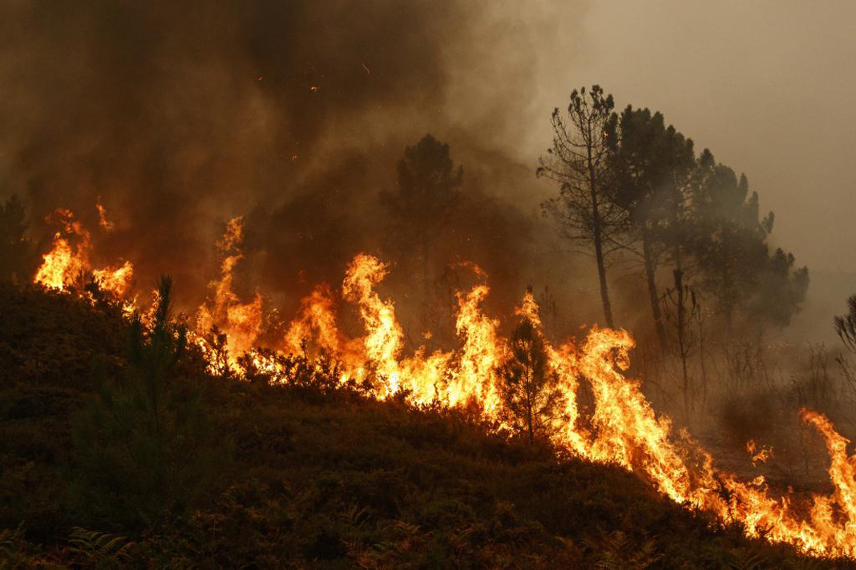
Existing features on the landscape
Containment opportunities
In response to Federal Fire Management Policy that dictates that all wildfires are managed for risk.
Living data
Something we already do
PODs are…
Notes:
Lets talk about what PODS are...
Existing features on the landscape that can be leveraged to control fire.
Containment opportunities that are viable in most fire conditions.
In response to Federal Fire Management Policy that dictates that all wildfires are managed for risk.
Living data – PODS are dynamic, and can be updated to reflect changing conditions on the landscape. Next year after this initial mapping effort, we can adjust lines, no big deal. Often the first few years after PODS are drawn, they change, sometimes significantly. These changes are due by May 1 evey year, and often happen during those shoulder seasons.
PODS and what they actually are is not something new, as Fire practitioners our brains are already drawing POD lines on the landscape thinking about on where I can hold a fire, where I need to not let a fire cross, or where a managed fire would provide benefit if I let it burn to that next ridge or road. Its just the process of drawing and calling them PODS that seems new, and its really just a formal way to document what we know, so that we can hold onto institutional knowledge as people retire, and we can hand off that knowledge to incoming resources to make the best decisions

Slide 6
PODs are NOT…
A decision
Created by computer models
Predetermined strategies or tactics
Predetermined fire perimeters
Intended to address Initial response
Intended to account for highly valued resources or assets (HVRAs)
Notes:
Just as important as defining what PODs are, there is a lot of value in defining what they are not….so PODS are not...
A decision....No NEPA is done on them- But they can be used to help inform and advise Fire fighters, responsible officials, and the public, County commissioners, emergency managers etc
Are not created from a computer model, models may inform where we draw lines, but they are created through cross boundary alignment
Predetermined strategies/tactics or Fire perimeters...We are not tying our hands here, We already instinctually identify things that may help us fight fire Like roads, Water sources, changes in fuel types and topography. These lines are a common ground for resources to consider where to engage with fires that are agreed upon by cooperators prior to expedite response planning. If you’ve heard that PODS are predetermining how we WILL fight fire in that area, it is a rumor, don’t put stock in it. Ive heard the narrative where if a fire occurs in this POD we MUST fight fire this way..thats not true. These are just a guide on where the best place is to hold a fire
Intended to address IA Response, We should still engage with aggressive Initial attack when appropriate.
are not intended to address HVRA’s…or at least at this point, although it may make us look a little closer at locations with WUI to draw lines to protect that resource. A subsequent application of PODS is summarizing HVRAs within their boundary for prioritization, but that will not be addressed in this workshop, that’s considered a potential phase 2

Slide 7
Summary
PODS are not intended to be pre-determined decisions. Since PODS are not decisions, they do not need to go through the NEPA process.
PODs and associated spatial fire planning products evolve as conditions change.
Emphasizes the role of the local fire managers over fire management
Notes:
PODS are not intended to be pre-determined decisions. Instead, they provide a variety of workable options rapidly.
Since PODS are not decisions, they do not need to go through the NEPA process.
PODs and associated spatial fire planning products evolve as conditions change.
Emphasizes the role of the local fire managers over fire management decisions (IA and EA, small and large) with the goal of reducing the complexity faced by IMTs.

Slide 8
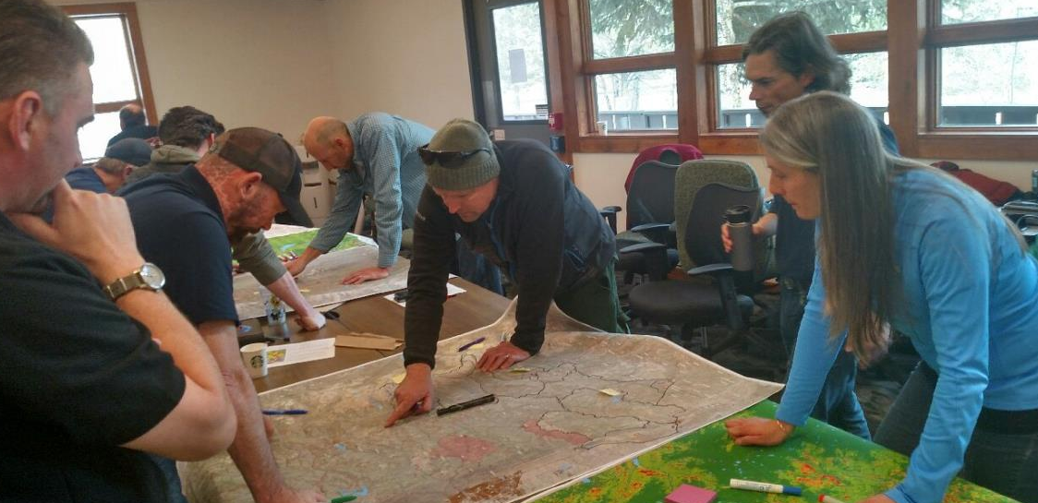
How do we draw POD lines?
Identify current Potential Control Locations on the Landscape
Utilize and put to use local expert knowledge.
Work across administrative boundaries
Look for opportunities to engage a fire – where can we be successful given the fuel type and topography
Look at maps with different data to refine POD lines
District breakouts, then come together as big group
Notes:
So what are these workshops going to look? How do we draw POD lines?
The workshop is where we start digging into spatial data and have those cross boundary discussions on where good operational lines would be
A critical concept of these workshops is that fire does not care about the arbitrary administrative boundaries we have, fire is going to move across the landscape as it wants. So we need to have cross boundary discussions; aligning landscape priorities BEFORE an incident occurs so when it does, we can hit the ground running.
Local knowledge is going to be key to getting these lines drawn on a map.
Data only gets us so far, local knowledge on what has worked in the past is going to be essential
We need to ask ourselves, when a fire occurs on the landscape, were are good locations for us to engage a fire; factoring in accessibility, firefighter safety, fuel type and topography
We also will have different maps with us, both printed and digital, to look at with different factors to consider to aid us in identifying these lines.
Start in district breakouts to have the conversation with that units SMEs on where to best put lines, and then we will come together as a forest to put together the puzzle pieces and have those conversations to make sure POD lines drawn on boarders make sense
Going to pause here to see if there are any specific questions on what to expect at the workshops before I dig into the data we will be working with

Slide 9
Data to consider...
Suppression Difficulty Index (SDI)
Rapid Risk Assessment
Roads
Topography
Burn Blocks
Fuel Treatments
Notes:
Some of the data we will consider...
Suppression difficulty index (SDI)
Rapid Risk Assessment done post Hurricane Helene
Roads
Topography – rivers, ridges
Burn Blocks – the consistency of burning that happens in NC is a great place to start drawing POD lines
Fuel Treatments – same as burn blocks, excellent start for POD lines
Going to look at a few of these more closely

Slide 10
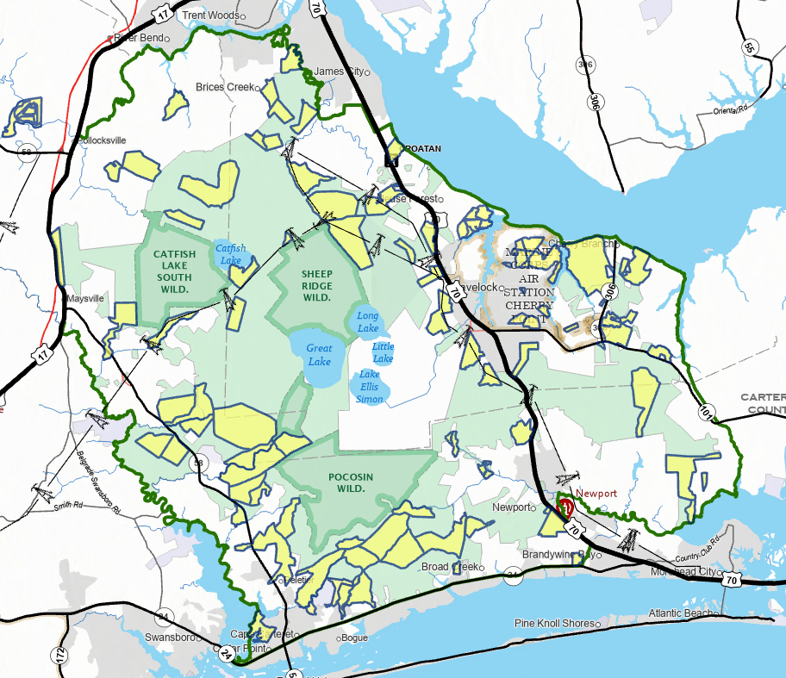
Burn Blocks
Existing planned areas
Operationally significant since the blocks are drawn where fire can be held
Notes:
Something the East excels at, that we don’t see anywhere else to this magnitude, is the use of prescribed fire and how often you are able to re-enter units, continuing to strengthen the work done in that area.
The basic concept of Burn Blocks (and fuel treatments) is excellent for a POD, since block boundaries are typically drawn where we can hold a fire, or where we can do some sort of strengthening to hold a fire there before ignitions begin.
In my opinion, a key to drawing the PODS in NC is harnessing these burn blocks and getting back to the basics of what a POD line is…which is where could we potentially hold a fire. Now im not saying we just copy paste burn blocks into the PODS network and walk away in 20 mins, but, I think they are an excellent starting Point for where we draw our POD lines. We have a good opportunity here to harness the good work you all do with prescribed fire.

Slide 11
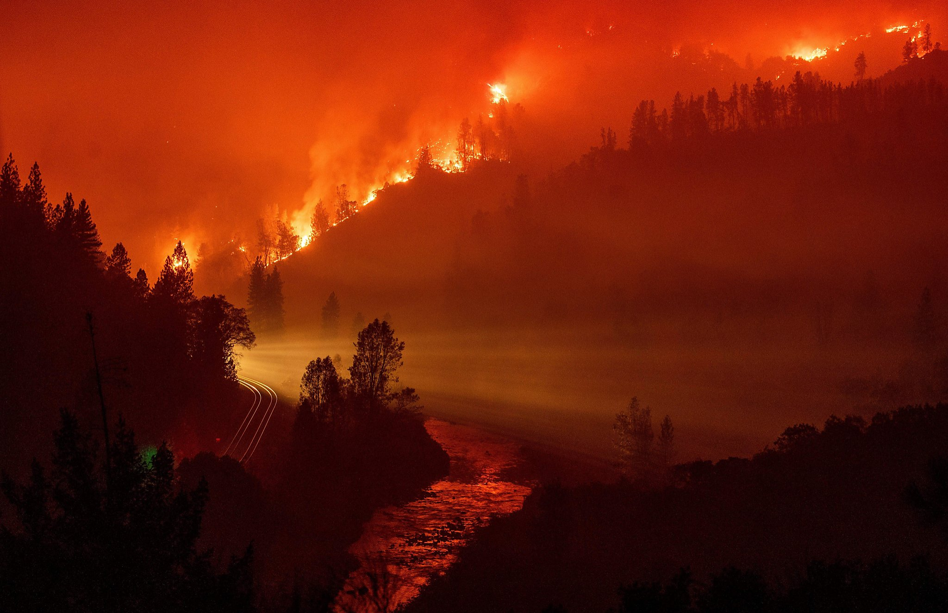
Applications
Fuel Treatment Funding
Post Disaster Summaries
Managed fire
Incident response
QWRA interface with PODs
Navigating the RMA dashboard
CWPP
Notes:
There are many applications for PODS, and many others are being developed and refined by end users with each passing year.
Fuel Treatment funding
We can create Disaster recover summaries in the containers POD lines create– this is unique to NC and hurricane helene
When is it perhaps appropriate to manage a fire for firefighter safety and let it burn into POD lines
Incident response
We can also summarieze QWRA into the bins PODS create,
Thes data will be on the RMA dashboard
Used as discussion points for CWPP
Ill go through a few of these applications in the following slides,

Slide 14
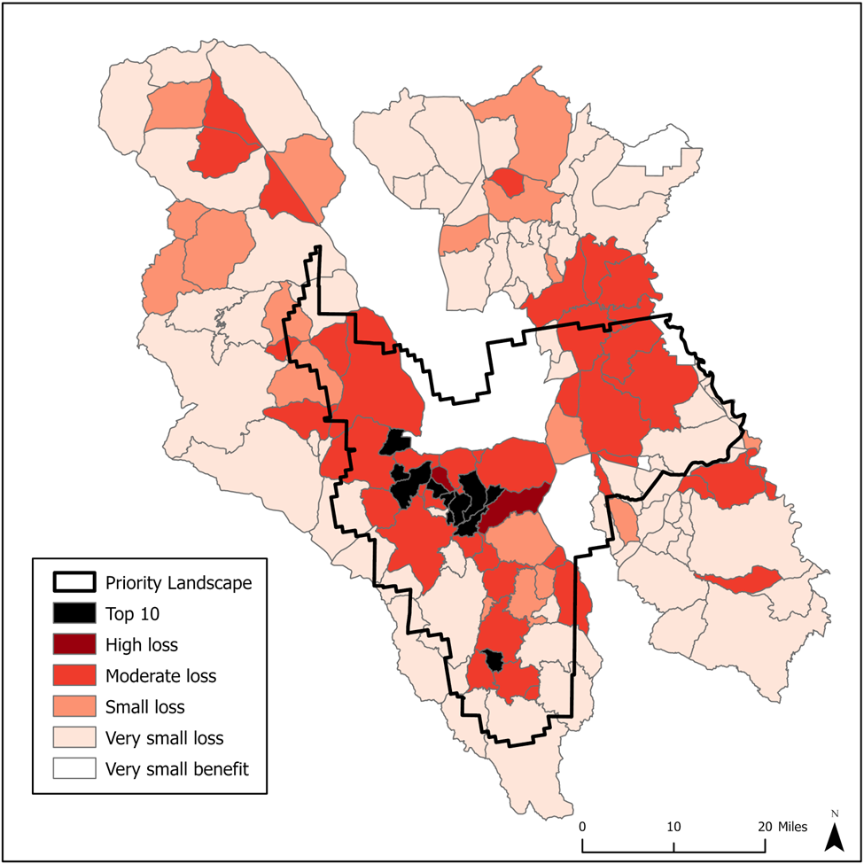
Potential Operational Delineations (PODs) Summaries
Can summarize data within each POD
Disaster Recovery
Values and Resources
QWRA
Notes:
A further application I have alluded to a few times is to summarize data into the containers, that our POD lines have created
Unique to NC are summaries that account for disaster recovery efforts in these PODS
We can summarize value and resource counts in each POD
Quantify our damage assessments to figure out what areas have the most damage and perhaps where we should focus our efforts first, (example bridge repair, trail repair, timber salvage etc)
A more common summary application
is to summarize Fire Risk results, which is what we see in the Picture of the Prescott here, showing where there would be either high loss or benefit to a specific resource
Doing that gives us a coarse-scale prioritization tool on where we can focus our fuels work, or where fire would provide benefit to a landscape (more on that in coming slides)

Slide 15
QWRA Outputs – Vulnerability and Hazard
Wildfire Risk Results
Where should we prioritize hazard mitigation treatments?
Where would managed fire provide the most benefit at the lowest risk of loss?
How does risk compare across ranger districts and national forests?
Notes:
The power of the QWRA process summarizing that data into these PODS is that it allows us to distill down complex inputs into a single map of risk that integrates fire modeling, values and assets, and expected responses.
Common outputs from a risk assessment are Vulnerability and Hazard based.
They can tell us where we should prioritize hazard mitigation efforts, where fire would provide a benefit and a loss, and POD summaries of these outputs allow us to quickly visually compare across ranger districts and national forests these results.

Slide 16
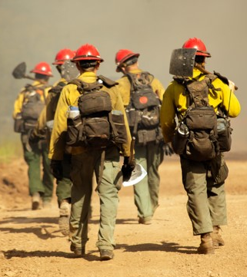
Incident Response
Notes:
PODS are used by CIMTs to develop long term incident response strategy – Going to look at a few examples of POD line intersects in Regions 1 and 3, and then Dave is going to show us how some of the data sets we are using at these workshops have already been examined during incidents in 2025

Slide 17
RMA Dashboard
2025 Incidents
SDI
Rapid Risk Assessment
Notes:
Take a dive into RMA Dashboard and look at incidents
Encourage people to start looking in RMA before the workshops
AAs considering using PODs to create Response Plans for incidents

Slide 18
Questions?
​
​
USDA Forest Service​
​
Keith Kelley – Fire Staff Officer – National Forests in NC

